Slide 1


BLG 223E - Recitation 2 Stacks and Queues
Wednesday, November, 6, 2024 Res. Assists. Meral Kuyucu & Alpaslan Tavukçu
korkmazmer@itu.edu.tr, tavukcu22@itu.edu.tr

Slide 2
Back to Basics: Void Pointers
A void pointer (void*) is a special pointer that can hold the address of any data type
Key Characteristics:
Can point to any data type
Can be converted to/from other pointer types
Cannot be dereferenced directly (must be type cast first)
Same size as other pointers on the system
Common Use:
void* malloc(size_t size);
void process_data(void* data, size_t size);

Slide 3
Back to Basics: Void Pointers
Type Casting Example:
int num = 42;
void* ptr = &num; // Store int address
int* int_ptr = (int*)ptr; // Cast back to int pointer
printf("%d\n", *int_ptr); // Access value: 42
Limitations:
Cannot perform pointer arithmetic
Cannot dereference without casting
No type checking by compiler
Cannot access members using -> operator

Slide 4
Back to Basics: Function Pointers in C
A pointer that stores the address of a function
Allows functions to be passed as arguments
Enables runtime selection of functions
Syntax:
// Declaration
return_type (*pointer_name)(parameter_types);
// Example
int (*operation)(int, int);
Simple Usage for Callback:
void process_array(int arr[], size_t size, int (*process)(int));

Slide 5
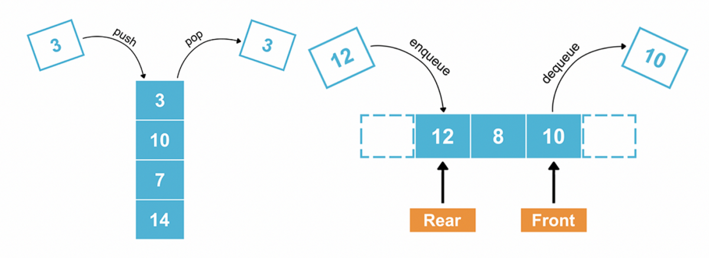
P1: Basic Stack Implementation
A stack is a Last-In-First-Out (LIFO) data structure.
Implement the following functions for a stack. Your stack should operate independent independent of data type.
init_stack: Initializes the stack.
push: Adds an item to the top.
pop: Removes the item at the top.
peek: Returns the item at the top without removing it.
is_empty: Checks if the stack is empty.
clear: Empties the stack and deallocates memory.

Slide 6
P2: Basic Queue Implementation
A queue is a First-In-First-Out (FIFO) data structure.
Implement the following functions for a queue. Your queue should operate independent of data type.
init_queue: Initializes the queue.
enqueue: Adds an item to the back of the queue.
dequeue: Removes an item from the front of the queue.
peek_front/peek_back: Views the front/back of the queue.
queue_is_empty: Checks if the queue is empty.
print_queue: Prints all elements in the queue.

Slide 7
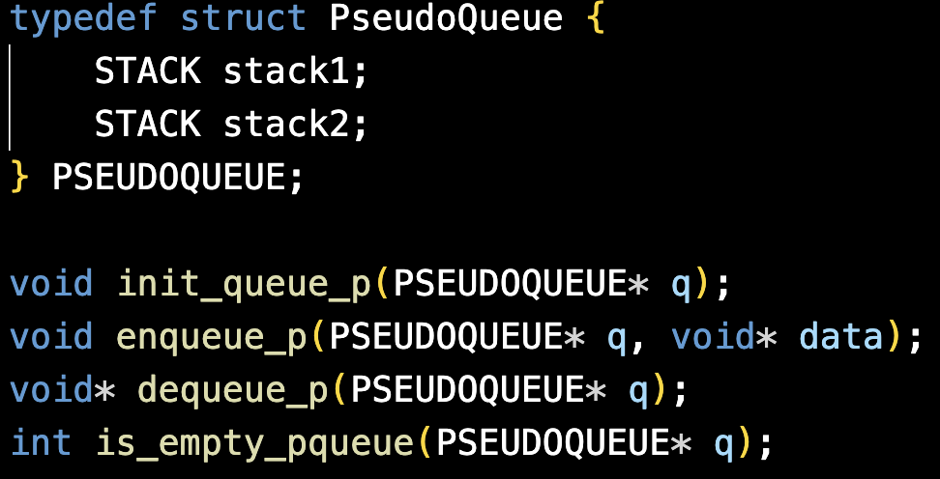
P3: Queue With Two Stacks
Implement the standard queue functions using two stacks. Your implementation should be mimicking a FIFO structure using two LIFO stacks.
init_queue_p: Initializes the pseudo-queue using two stacks.
enqueue_p: Enqueues an item by pushing it onto stack1.
dequeue_p: Dequeues an item by transferring items from stack1 to stack2 to reverse order.
is_empty_pqueue: Checks if both stacks are empty, which indicates an empty queue.

Slide 8
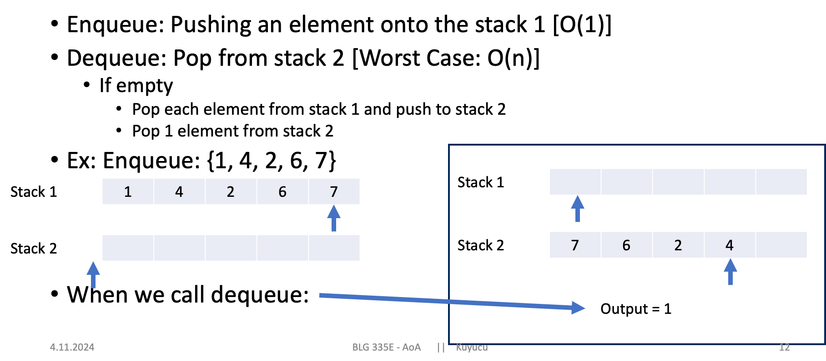
P3: Queue With Two Stacks

Slide 9
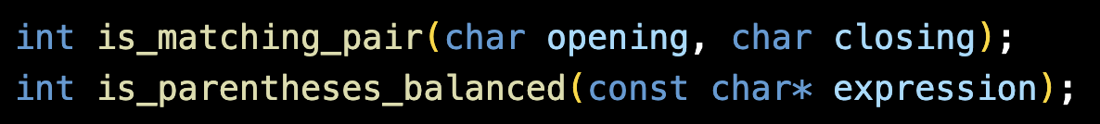
P4: Parenthesis Checker
Validate if an expression has balanced parentheses
(e.g., {[()]} is balanced, {[(])} is not).
Uses a stack to push opening brackets and pop them when matching closing brackets are found.
is_matching_pair: Checks if two characters (opening and closing) form a valid pair.
is_parentheses_balanced: Uses a stack to check if all parentheses in the expression are balanced.

Slide 10
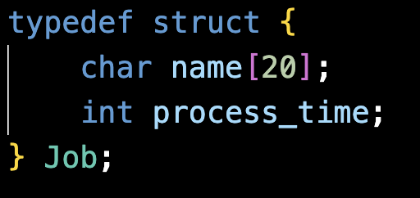
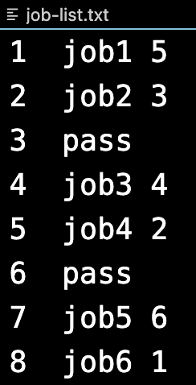
P5: Processor Queue Simulation
Each job has two fields: name and process time. Process time represents the amount of time required by the processor to complete the job. The keyword "pass" is used as a placeholder to indicate there is no incoming job at that time.
The following steps are repeated until the queue becomes empty and all lines in the file are processed:
Read from the file to check if there is any incoming job.
If a job is found, add it to the queue.
Retrieve a job from the queue (if available).
Run the CPU for 1 unit of time (i.e., decrease the job's process time by 1).
If the job is not yet completed, re-enqueue it.
Note: This is a simplified model of real CPU behavior. The purpose of this design is to provide practice with queue operations.

